Slide 1
Water Power

Slide 2
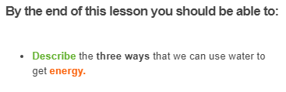


Slide 3
All the earth's water moves through the water cycle.
This is a process which describes how water cycles through the oceans, rivers, and atmosphere.

Slide 4

There is a finite amount of water and no water can be added or removed from the cycle.
Therefore the energy we can harness from water is considered renewable.

Slide 5
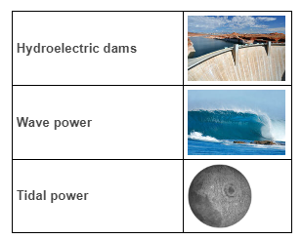
The energy from water, sometimes called hydro energy, makes up over 60% of Australia's renewable energy supply.
But how can such a hot, dry, country like Australia get so much energy from precious water?
A lot of the power generated by water is using the movement of water. Water can be used to generate power through:

Slide 6
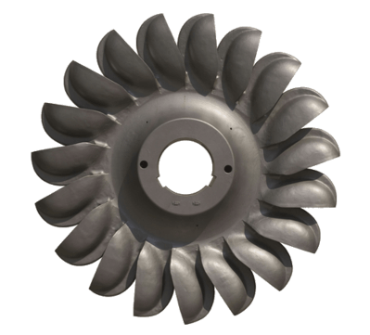
The kinetic energy (energy of moving objects) of water can be used to turn turbines and create electricity.
The kinetic energy is transferred to the rotors of the turbine to make them rotate.
The turbines are connected to a generator, which converts the kinetic energy into electrical energy.

Slide 7
Over 15% of Australia's renewable energy is produced by hydroelectric power plants.
Hydroelectric power plants often use dams to create a height difference between two bodies of water. Then the energy of the falling water turns a turbine, creating electricity.

Slide 8
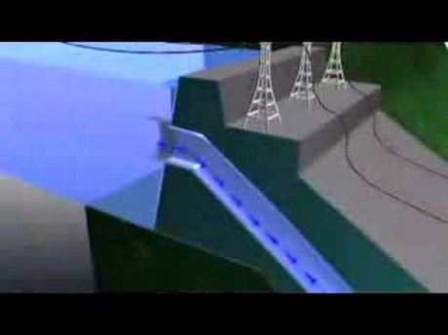

Slide 9
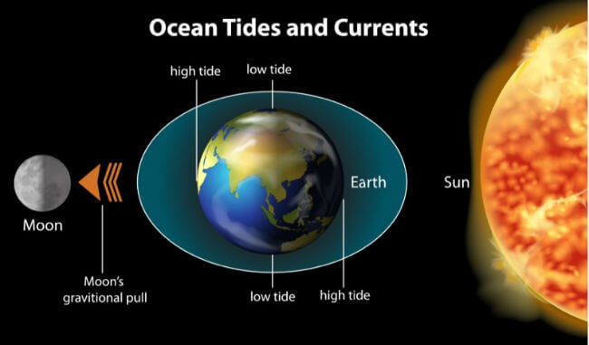
Tides are the rising and falling of the oceans.
When you go to your favourite beach or harbour the water appears higher or lower at different times of the day.
This is the tide and it is caused by the gravitational pull of the sun and moon on the earth.

Slide 10
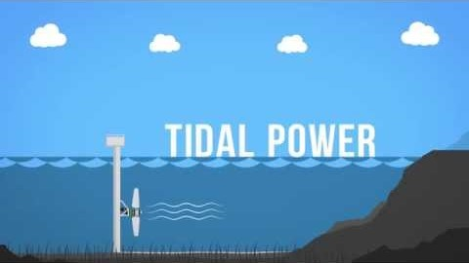

Slide 11
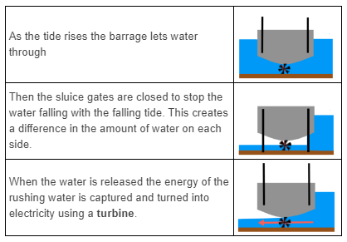
Tidal energy can be captured using a tidal barrage.
Tidal barrages are put in places where there is a big difference between the height of the water at high and low tide.

Slide 12
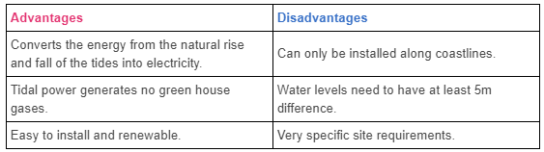
Tidal power is a useful source of renewable, clean energy.
However, just like any source of power it has its advantages and disadvantages.

Slide 13

Waves are created by the wind transferring some of its energy to the water through friction.
The energy from ocean waves can be used to generate electricity.

Slide 14
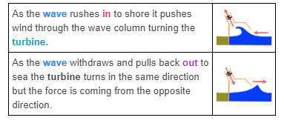
An oscillating wave column works using the air and pressure from crashing waves to turn a turbine.

Slide 15
